Slide 1
Apple Music marketing analysis
How Apple Music can increase sales and compete with Spotify which is currently the leading music streaming app

Slide 2
The problem
Company
Context
Problem statement
With Apple Music, you can access millions of songs, curated playlists and radio, and music recommendations.
Spotify has gained popularity and is currently ruling the market.
We need to bridge this growth gap and device a marketing strategy to become the number 1 music streaming app.
Customer base of apple music is declined by 21%.
Total number of music subscribers is extremely less compared to Spotify.
Thus, revenue has been affected considerably .

Slide 3
Solution
Build a system using Google Cloud Platform which will ingest statistical marketing data of Apple and Spotify for analysing trends and differences.
More subscribers - More revenue

Slide 4
Implementation

Slide 5
GCP Architecture
1. Capture the marketing data of Apple Music and Spotify
2. Build a system in which cloud pub/sub will ingest data files in batches
3. Cloud data flow transforms the JSON file into structured, schema-based data
4. That data will be loaded into the BigQuery analytics engine
5. This data will then be fed to BI tools(Tableau/PowerBI) for data analysis.
6. The data set endpoints will be provided to other teams for their analysis.
09.05.XX
10.20.XX

Slide 6
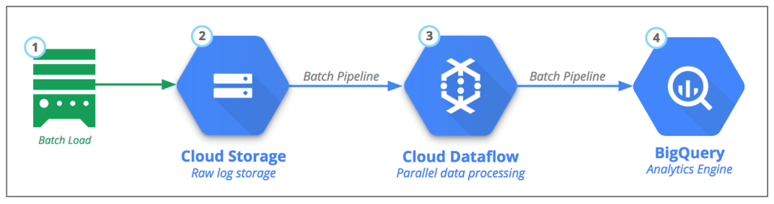
Batch Processing of input files

Slide 7
Data to be used for analysis
Monthly active users by age
Monthly active users by region
Subscribers worldwide
Time spent on the app by age and platform
Unique global visitors
Total revenue

Slide 8
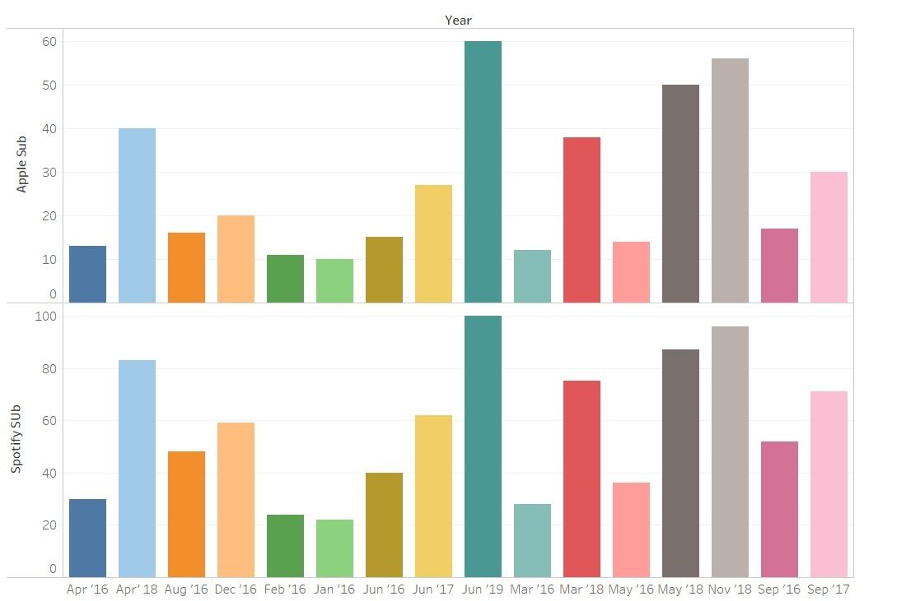
Comparison analysis of number of subscribers over a period of three years

Slide 9
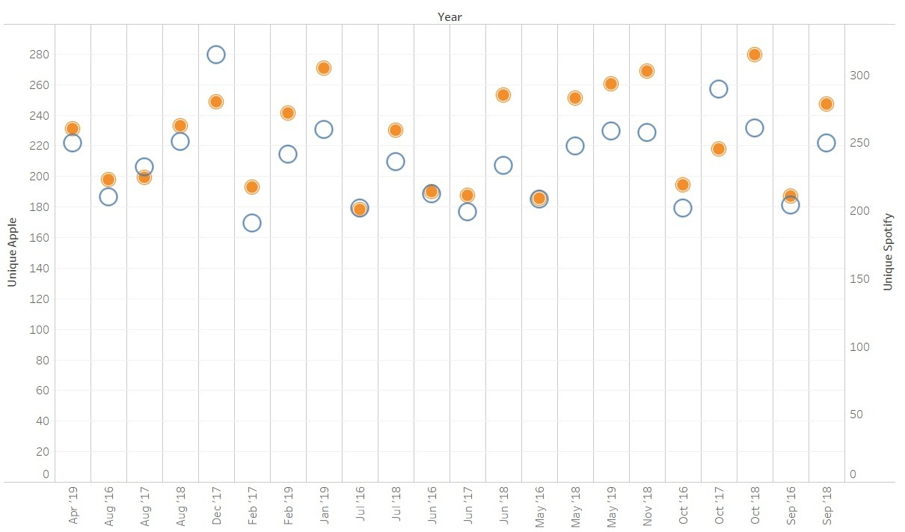
Scatter plot displaying number of unique visitors

Slide 10
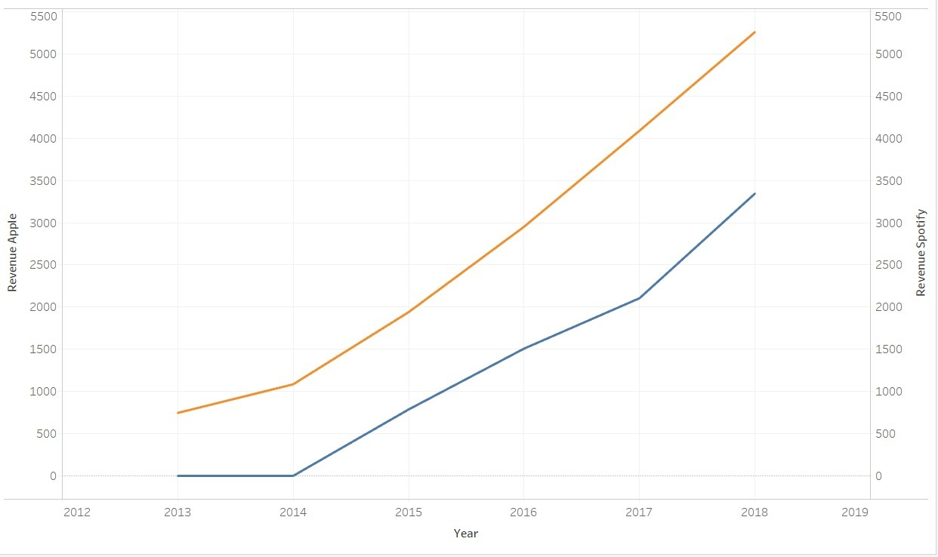
Comparison of revenue generated

Slide 11
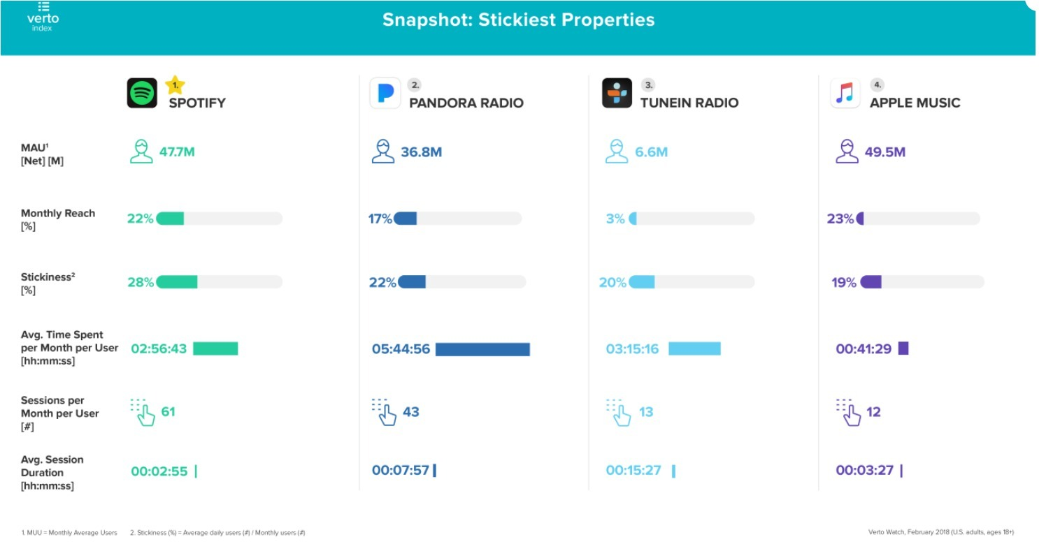
Table displaying stickiness properties

Slide 12
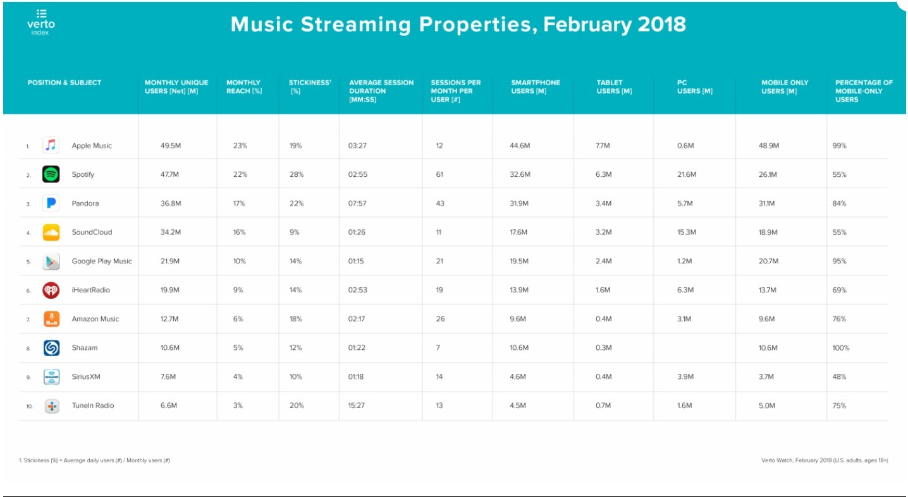
Comparing different streaming apps

Slide 13
BigQuery Data Analysis

Slide 14
Use Case 1
Our analysis shows that, age groups between 18 to 35 are maximum subscribers which is dominated by Spotify.
Analyzing data for age and gender demographics

Slide 15
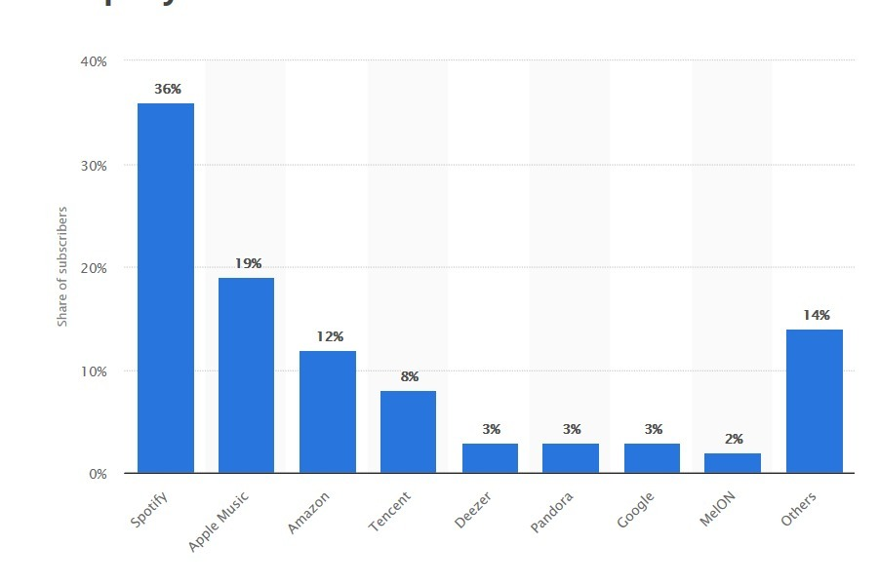
Percentage share of subscribers is highest for Spotify

Slide 16
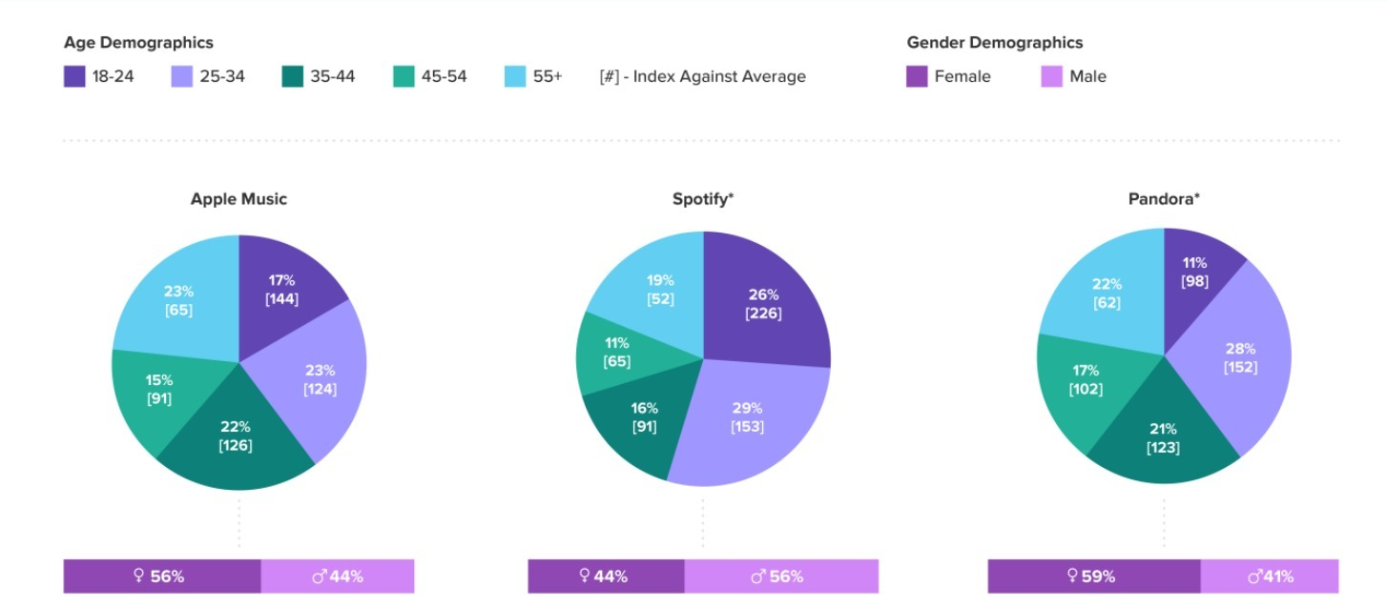
Subscribers by age and genders

Slide 17
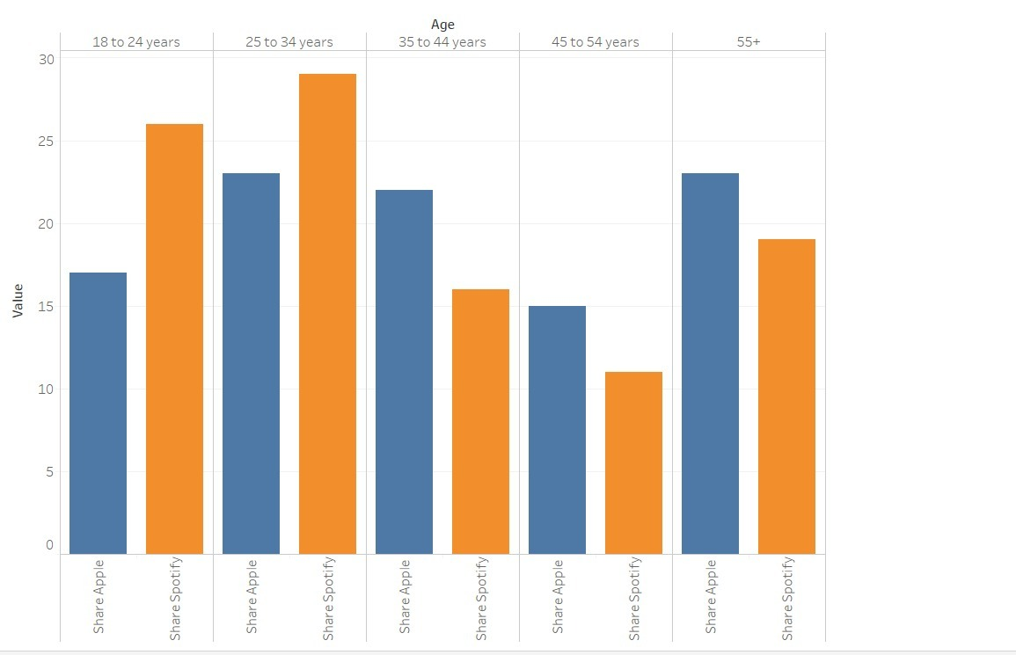
Subscribers by age

Slide 18
Our Suggestion for Use Case 1
For Age Group 18-24, we can implement following steps
Create student plans
Send Personalized emails of the offers that can be accessed by university IDs
For Age Group 25-34, we can
Create attractive long term offers
Provide free period when they buy Apple Products.
09.05.XX
10.20.XX

Slide 19
Use Case 2
Our analysis shows that, Apple Music dominates in the USA but in other global regions it lags behind Spotify.
Analyzing region wise data

Slide 20
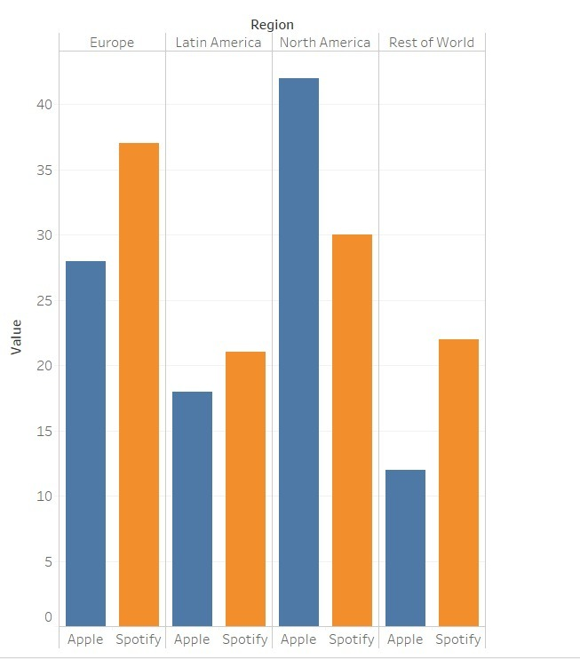
Region wise number of subscribers

Slide 21
Our Suggestion for Use Case 2
Providing longer trial period to attract more customers world wide.
Coupling Apple Music with local plans.
Advertising plans through Social Media.
09.05.XX
10.20.XX

Slide 22
Use Case 3
According to google, recommendation system is better for Spotify as compared to Apple. Tailored music is one of the most important features for user subscriptions.
Analyzing recommendation system

Slide 23
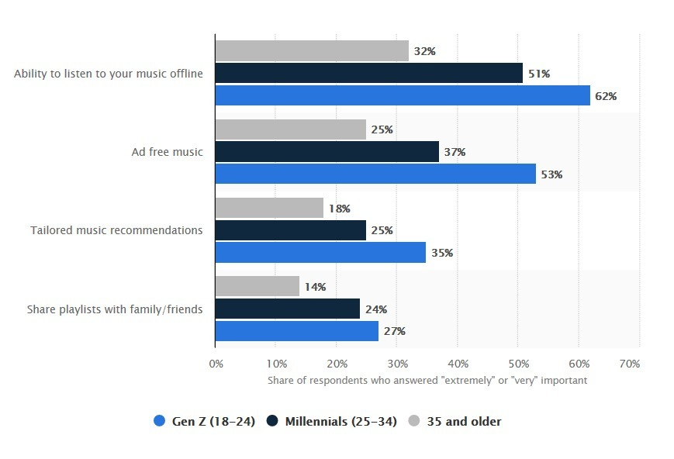
Important features by age group

Slide 24
Our Suggestion for Use Case 3
Apple needs to improve its recommendation system drastically.
As we see that both have same plans wrt amount and both provide music streaming offline. As per the previous graph we can see that Tailored Music plays a big part and Apple can do that by improving the recommendation system.
Apple also lags behind Spotify in free subscription. They can also start giving free subscription with Ads like Spotify to acquire more Customers.
09.05.XX
10.20.XX

Slide 25
Team 2 Analysis

Slide 26
Use Case 1
We can see Comcast acquires their potential customers from either banner ads or social networking sites.
More personalized way of gaining potential customers

Slide 27
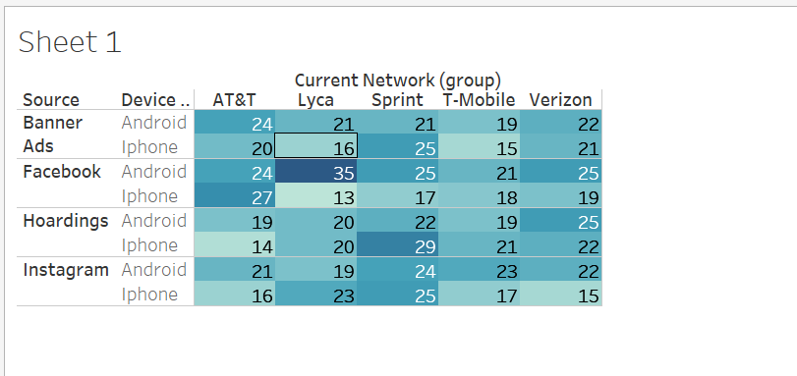
Potential customer sources

Slide 28
Our Suggestion for Use Case 1
From the data source, we know that the email ids of most of the potential customers were present in the data source.
So, we recommend taking more private marketing approach. We can do this by sending emails to such customers to get their attention faster.
09.05.XX
10.20.XX

Slide 29
Use Case 2
From the analysis we can see the most used apps by customers.
Providing attractive plans

Slide 30
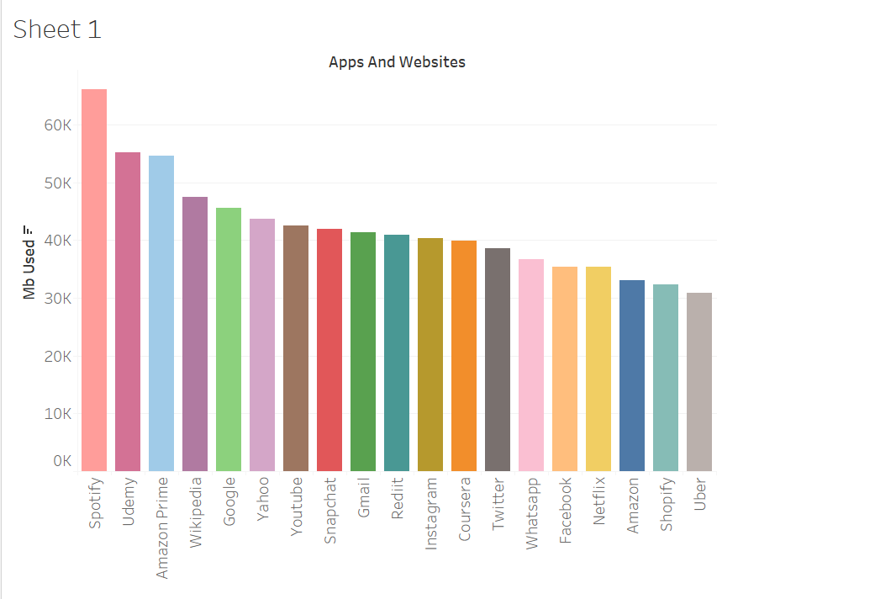
Apps used most by customers

Slide 31
Our Suggestion for Use Case 2
The insights show that, if we create attractive monthly/yearly subscription plans of longer duration which will interest the customers. This will not only help in gaining potential customers but also help with customer retention
Provide discounts for most used apps.
09.05.XX
10.20.XX

